Slide 1
A Comparative Performance Analysis of LDPC Coded SCMA with Different types of Multiple Access Schemes
ECE
Presented By
Supervised By
Jinnaton Nessa Laboni
Student ID: 180906
Dr. Mohammad Ismat Kadir
Professor
Shatu Karmokar
Student ID: 180922
External Member,
Dr. Md. Abdul Alim
Professor
Electronics and Communication Engeering discipline
Khulna University , Khulna
Member,
All Faculties Of ECE Discipline
Electronics and Communication Engineering Discipline
Khulna University, Khulna
ECE@KU
ECE@KU

Slide 2

Outline
ECE
INTRODUCTION
MOTIVATION
CONTRIBUTION
SYSTEM REVIEW
SIMULATION RESULT
FUTURE WORK
CONCLUSION
REFERENCES
ECE@KU

Slide 3
Introduction
ECE
There is no substitute for digital wireless communication in the era of modern science. The fundamental conditions for wireless communication are,
High data Transmission rate
Low latency
High spectral efficiency
Ultra reliable audio and video transmission
Flexible synchronization
ECE@KU

Slide 4
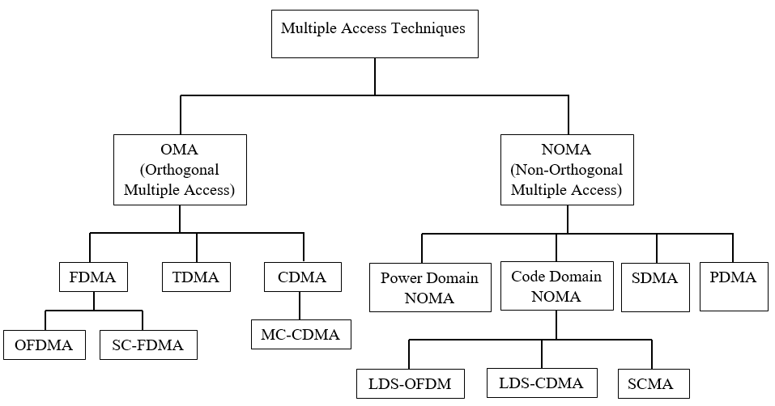
Introduction
ECE
Some multiple access schemes have been developed to address the requirements of wireless communication. Such as
ECE@KU

Slide 5
Introduction: OFDM
ECE
Instead of using a single Wideband channel frequency, OFDM distributes a single information stream across a number of closely spaced narrowband subchannel frequencies. OFDM is a popular modulation technique of 4G wireless communication.
Instead of using a single Wideband channel frequency, OFDM distributes a single information stream across a number of closely spaced narrowband subchannel frequencies. OFDM is a popular modulation technique of 4G wireless communication.
Advantages:
Robust against multi path fading
Robust against inter-symbol-interference (ISI)
High spectral efficiency
Efficient implementation using FFT
Disadvantages:
Sensitive to Doppler shift
High peak-to-average-power ratio (PAPR)
Sensitive to frequency synchronization problems
Poor synchronization
ECE@KU

Slide 6
Introduction: OFDMA
ECE
Essentially, OFDMA is an application of OFDM for multiple users. In order to accommodate numerous users—even those with significantly different use patterns or data loads—it allocates in both the time domain and the frequency domain.
Advantages:
Increased channel capacity
Improved signal quality
Reduced interference
Efficient implementation using FFT
High spectral efficiency
Disadvantages:
Increased channel capacity
Improved signal quality
Poor synchronization
Co-channel interference is more complex than CDMA
ECE@KU

Slide 7
Introduction: CDMA
ECE
ECE@KU

Slide 8
Introduction: LDS-CDMA
ECE
ECE@KU

Slide 9
Introduction: SCMA
ECE
ECE@KU

Slide 10
Introduction : Polar Coded SCMA
ECE
ECE@KU

Slide 11
Motivation
ECE
The reason for conducting this research,
Faster Access
Greater Transmission rate
High performance in low BER
Improve spectrum efficiency
ECE@KU

Slide 12
Contributions
ECE
The main contribution of this thesis
We have designed LDPC coded SCMA scheme on the rayliegh fading channel.
Analyzing performance between SCMA, Polar Coded SCMA, LDPC Coded SCMA
A comparative performance analysis between different types of multiple access.
ECE@KU

Slide 13
System Overview: Polar Coded SCMA
ECE
ECE@KU

Slide 14
System Overview: LDPC Coded SCMA
ECE
ECE@KU

Slide 15
System Overview: LDPC Coded SCMA
ECE
ECE@KU

Slide 16
System Overview: LDPC Coded SCMA
ECE
ECE@KU

Slide 17
System Overview: LDPC Coded SCMA
ECE
ECE@KU

Slide 18
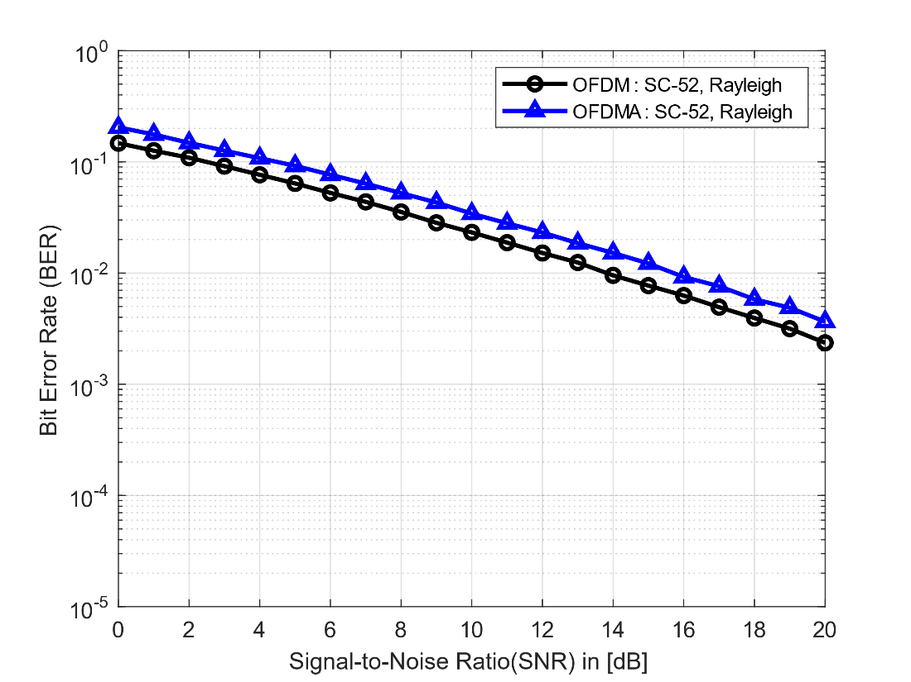


Simulation Result
ECE
Bit-error-rate vs signal-to-noise ratio of both OFDM and OFDMA scheme.
Here,
number of subcarriers = 52
number of symbols = ${10}^{4}$
FFT size = 64
Bit-error-rate vs signal-to-noise ratio of both OFDM and OFDMA scheme.
Here,
number of subcarriers = 52
number of symbols = ${10}^{4}$
FFT size = 64
ECE@KU

Slide 19
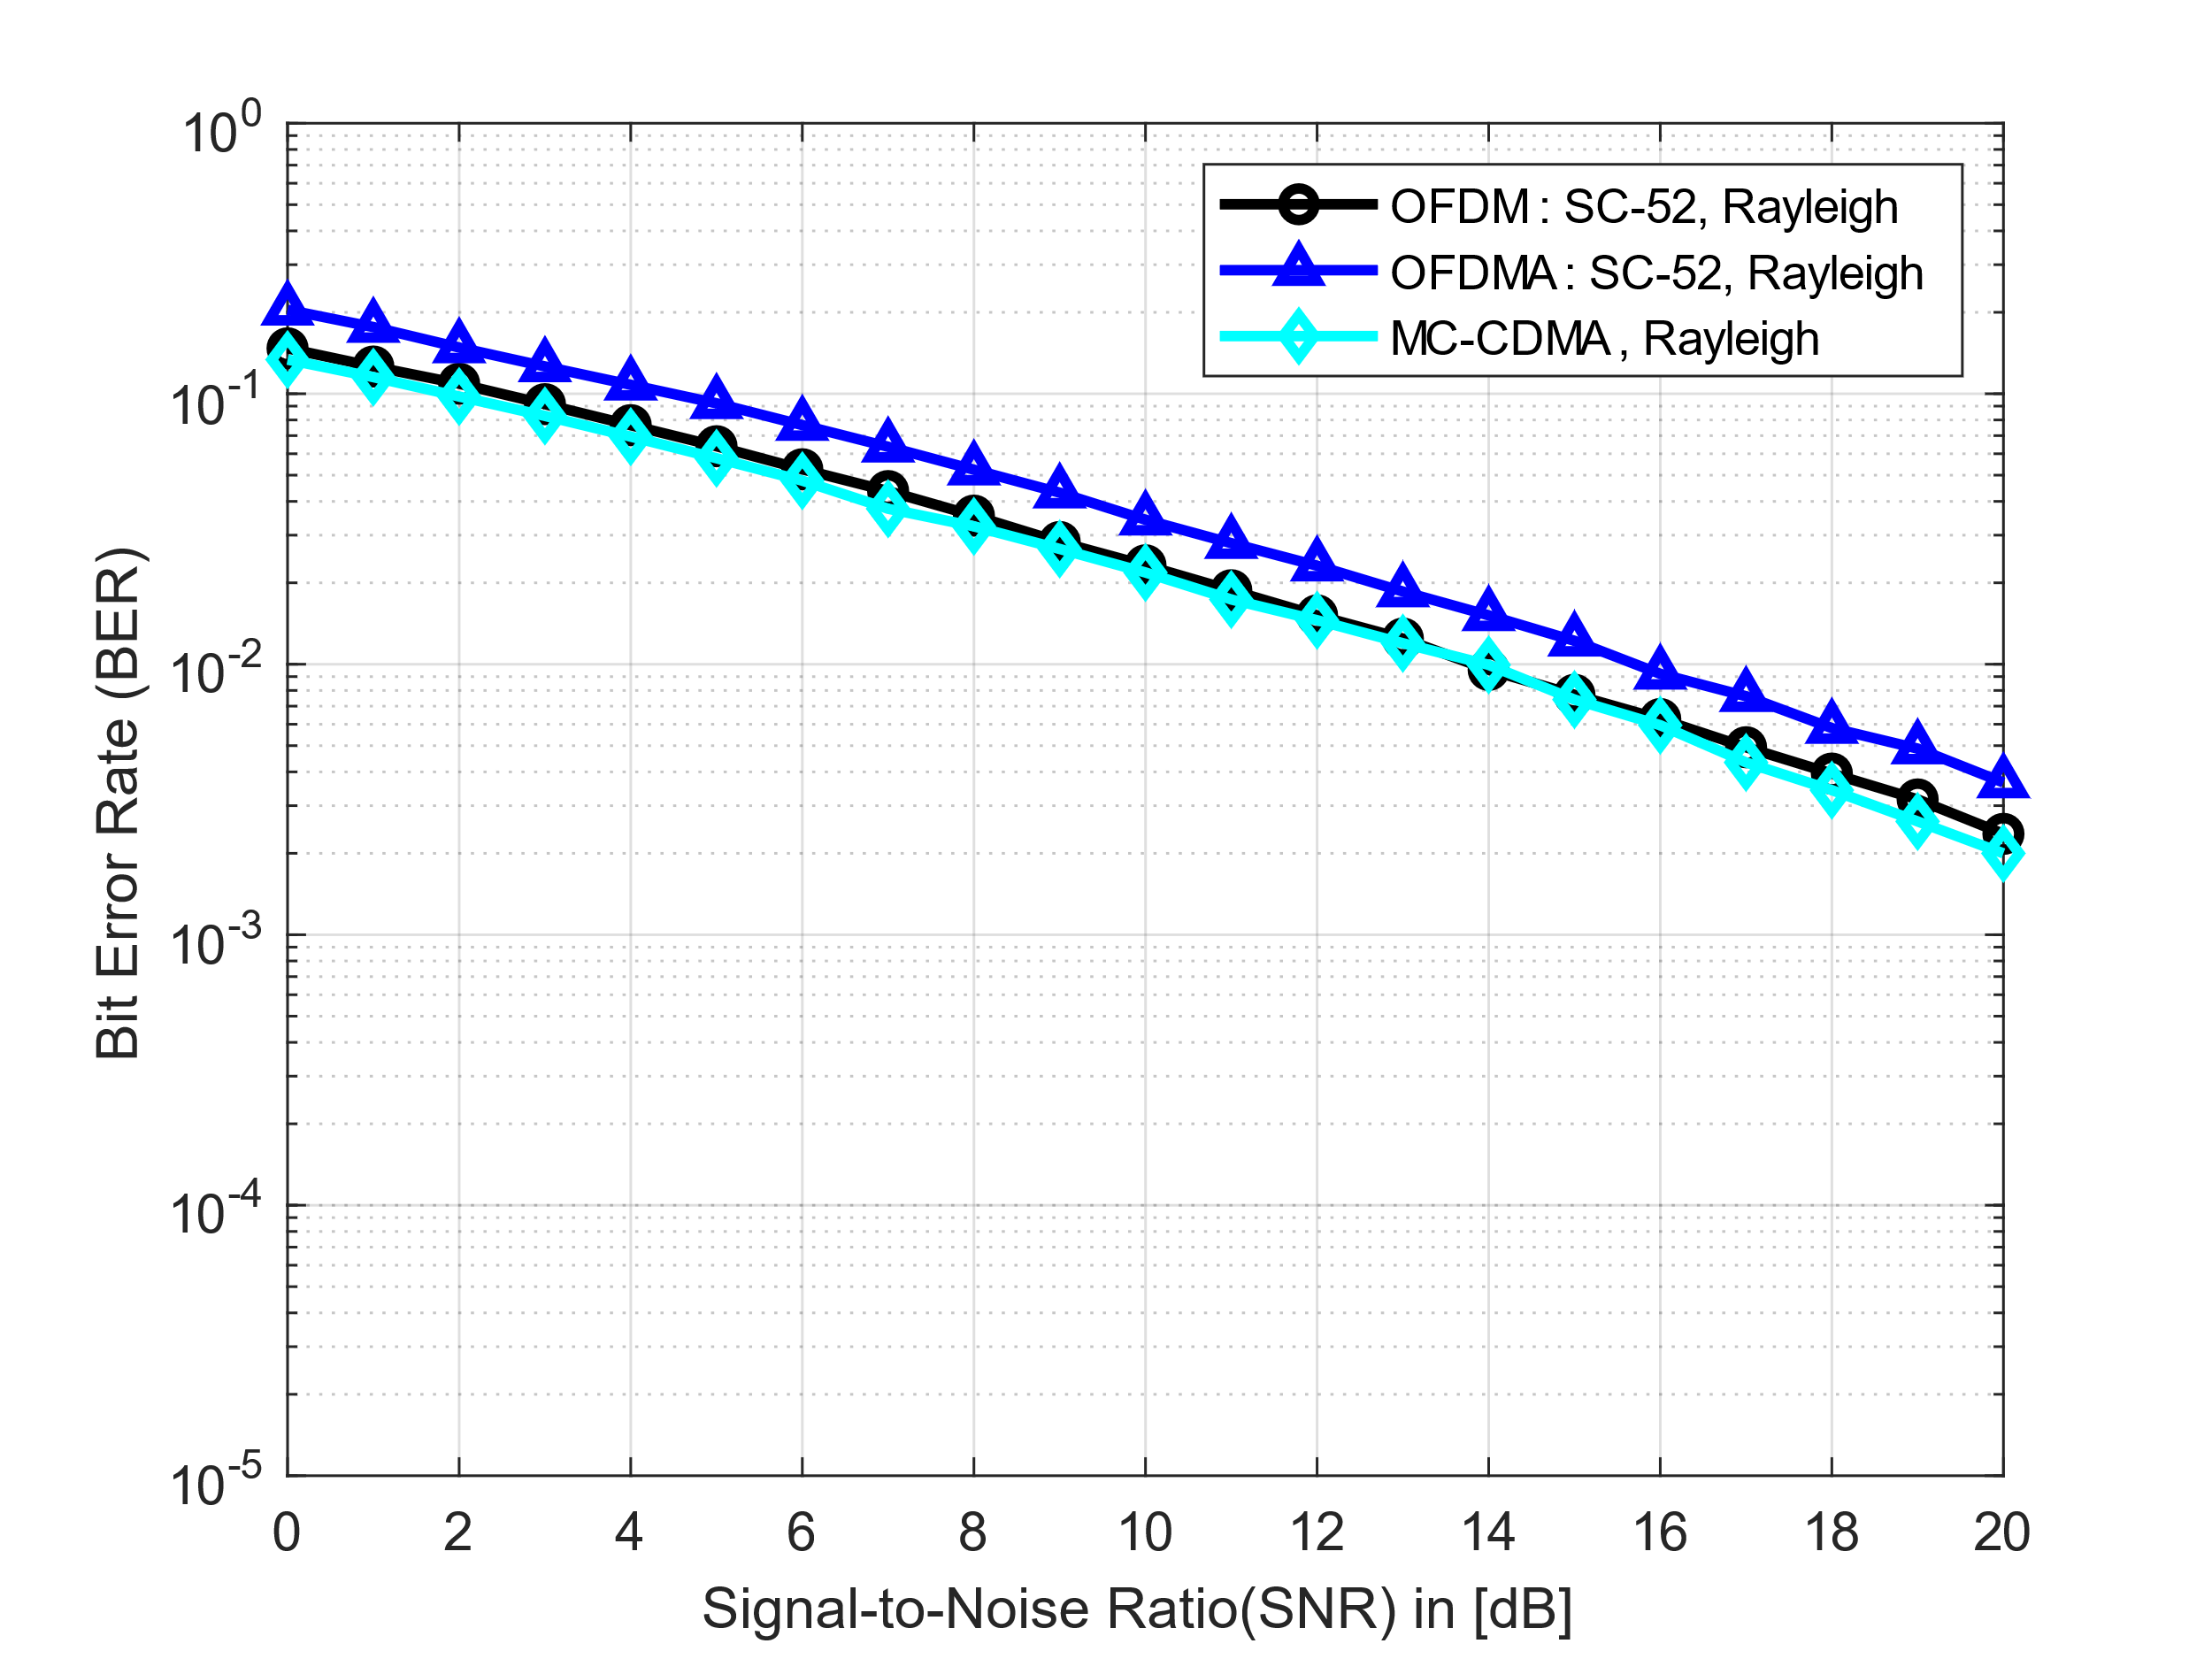
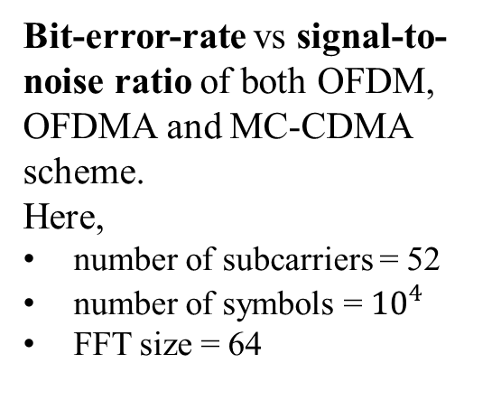
Simulation Result
ECE
Bit-error-rate vs signal-to-noise ratio of both OFDM, OFDMA and MC-CDMA scheme.
Here,
number of subcarriers = 52
number of symbols = ${10}^{4}$
FFT size = 64
ECE@KU

Slide 20
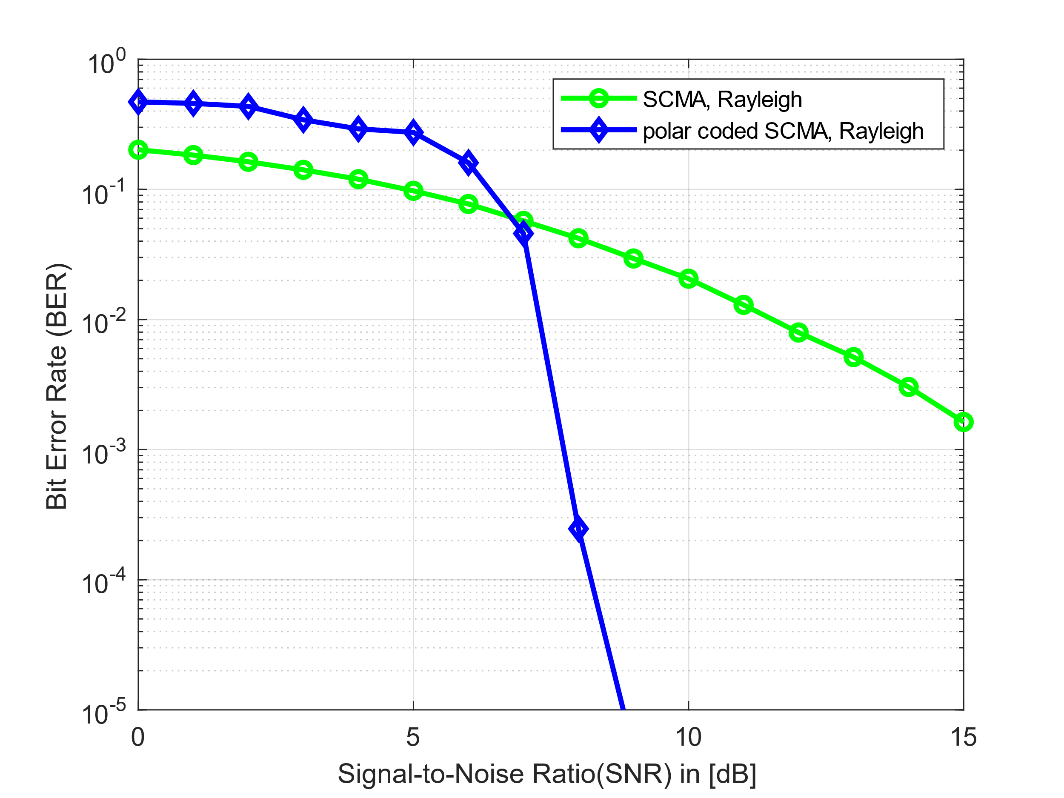
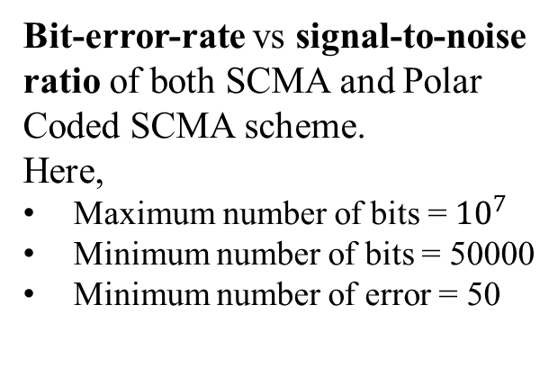
Simulation Result
ECE
Bit-error-rate vs signal-to-noise ratio of both SCMA and Polar Coded SCMA scheme.
Here,
Maximum number of bits = ${10}^{7}$
Minimum number of bits = 50000
Minimum number of error = 50
ECE@KU

Slide 21
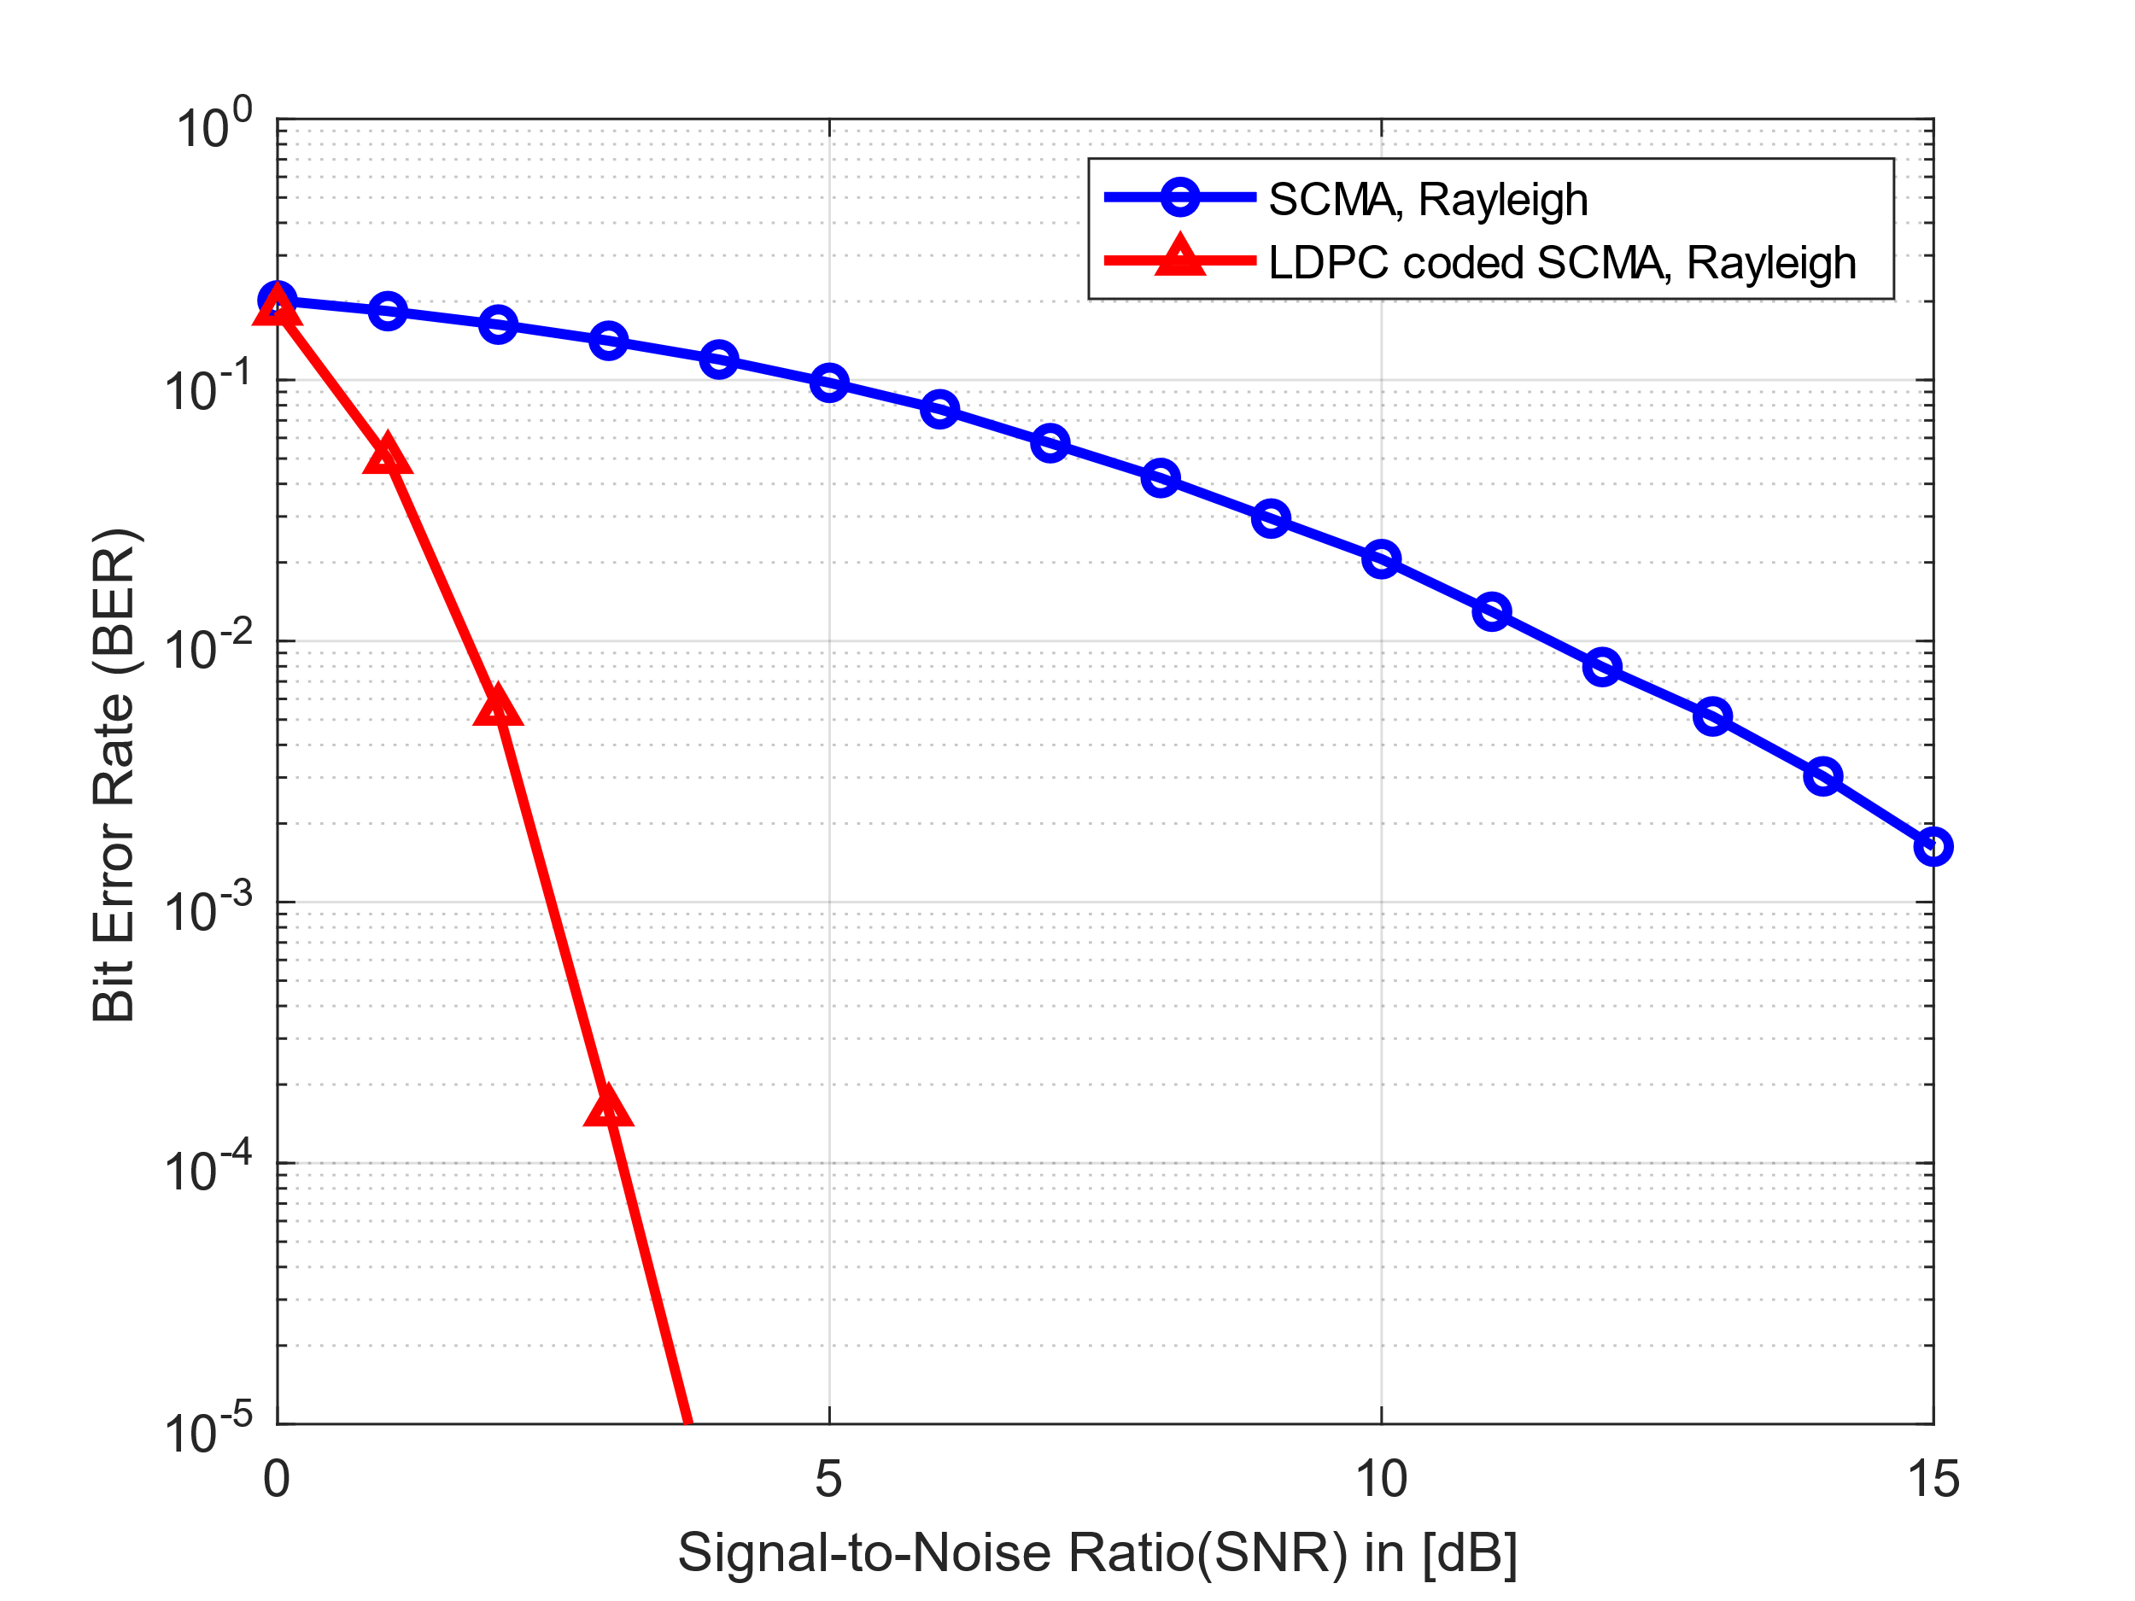
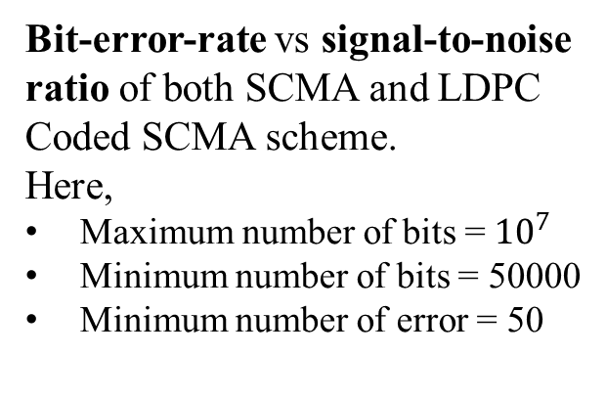
Simulation Result
ECE
Bit-error-rate vs signal-to-noise ratio of both SCMA and LDPC Coded SCMA scheme.
Here,
Maximum number of bits = ${10}^{7}$
Minimum number of bits = 50000
Minimum number of error = 50
ECE@KU

Slide 22
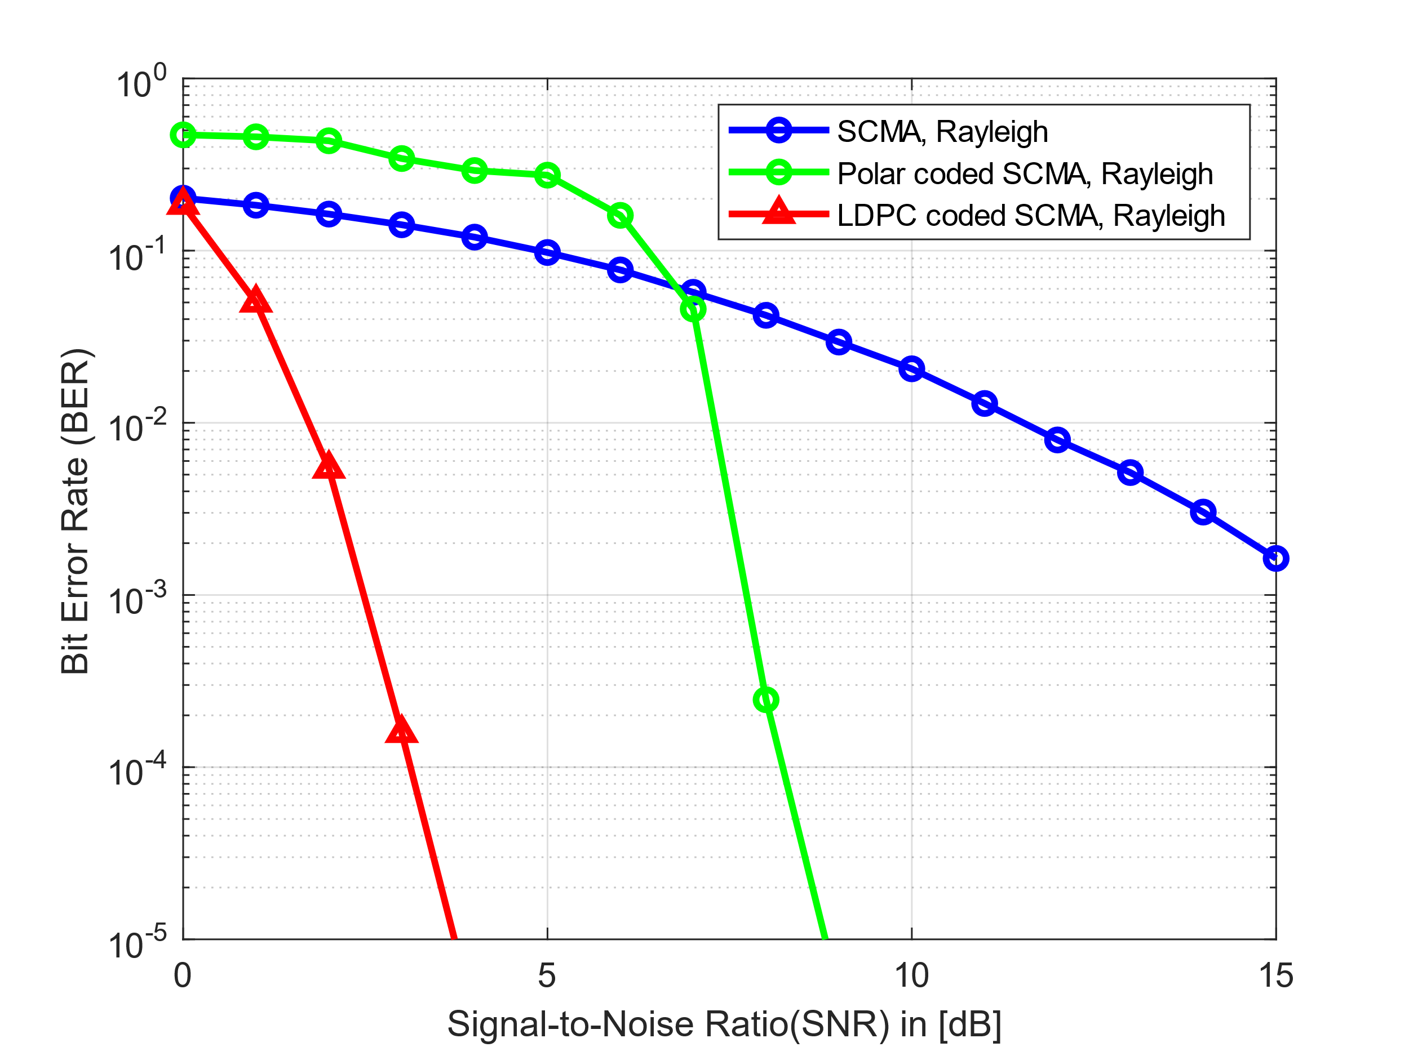
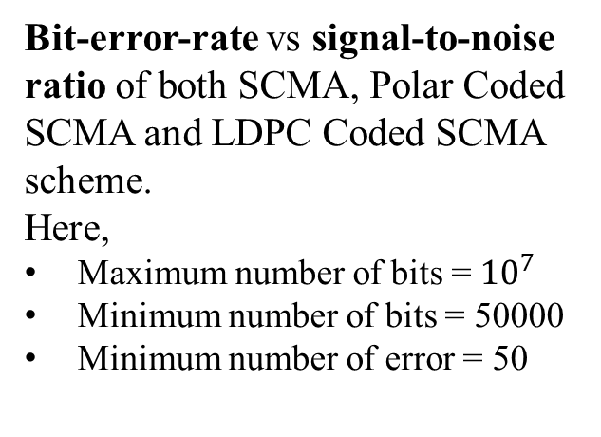
Simulation Result
ECE
Bit-error-rate vs signal-to-noise ratio of both SCMA, Polar Coded SCMA and LDPC Coded SCMA scheme.
Here,
Maximum number of bits = ${10}^{7}$
Minimum number of bits = 50000
Minimum number of error = 50
ECE@KU

Slide 23
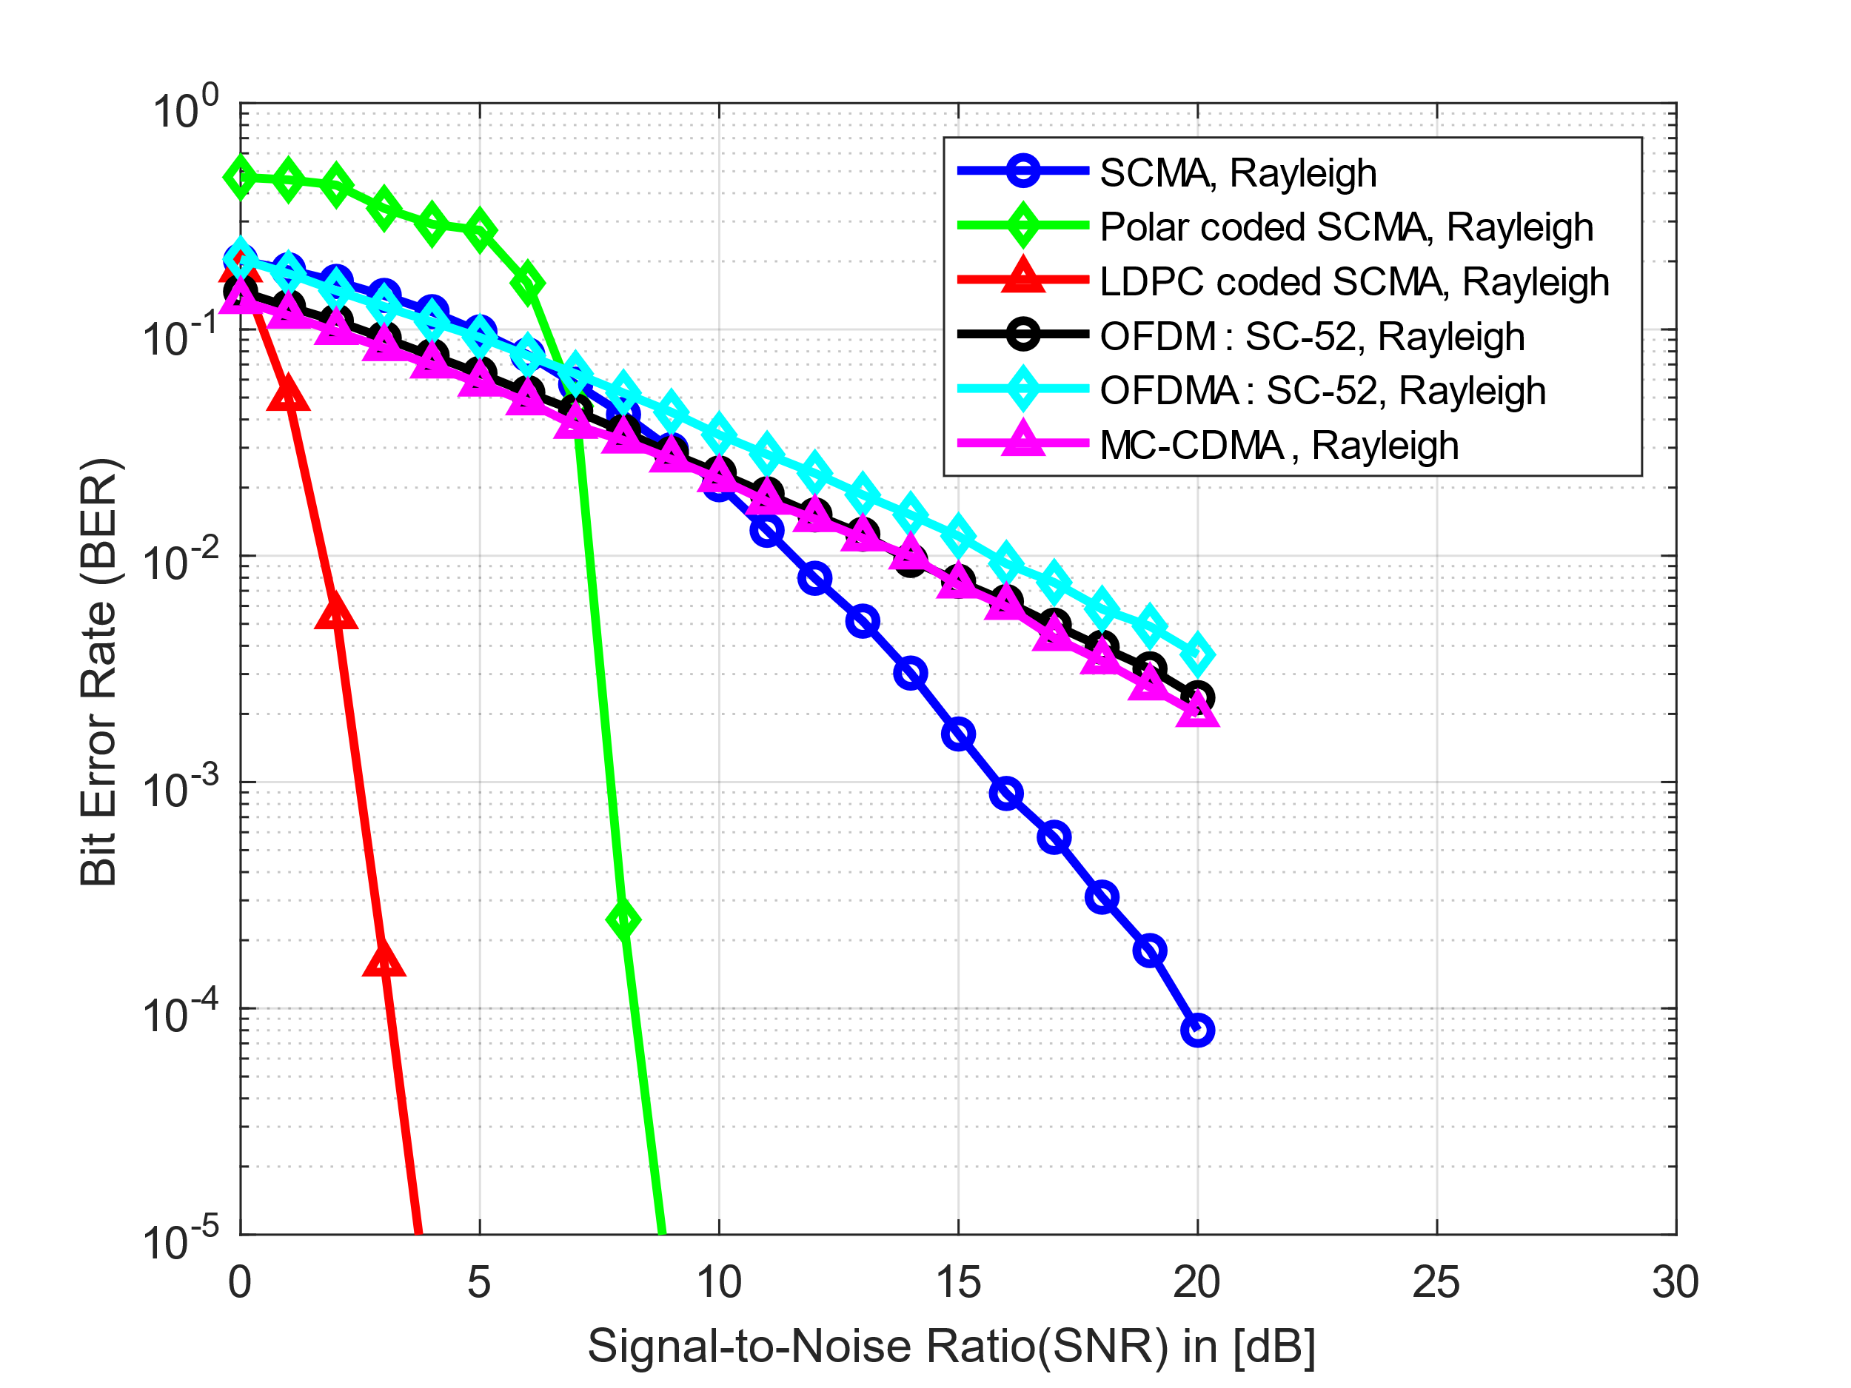
Simulation Result
ECE
Bit-error-rate vs signal-to-noise ratio of both SCMA and Polar Coded SCMA scheme.
Here,
Maximum number of bits = ${10}^{7}$
Minimum number of bits = 50000
Minimum number of error = 50
ECE@KU

Slide 24
Future Work
ECE
ECE@KU

Slide 25
Conclusion
ECE
ECE@KU

